Slide 1
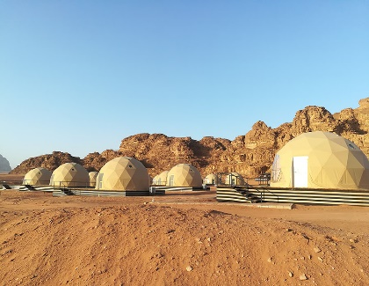
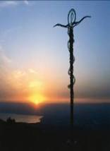
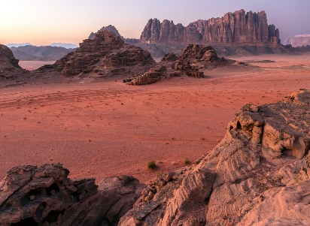
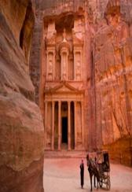
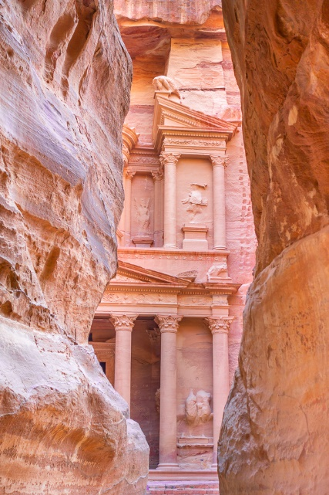
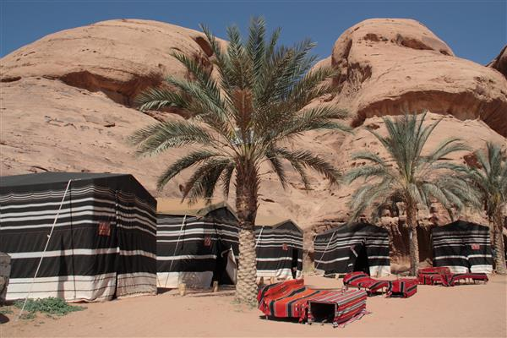
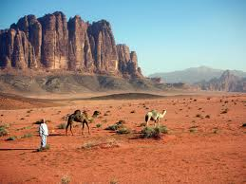
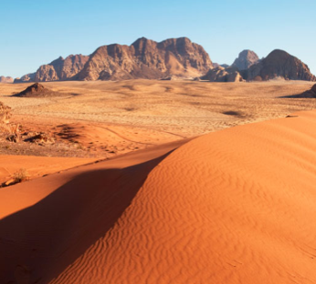
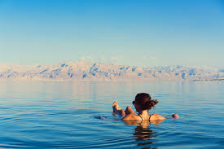
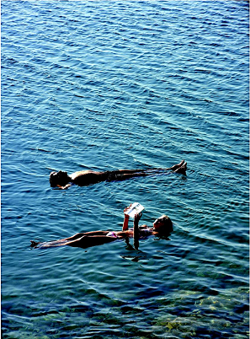
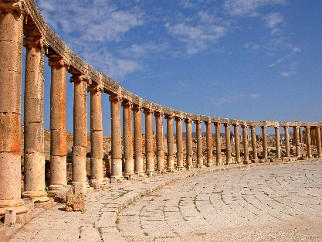
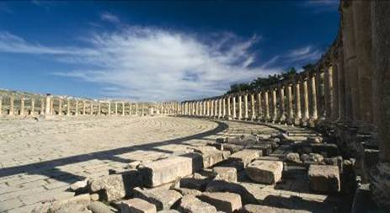
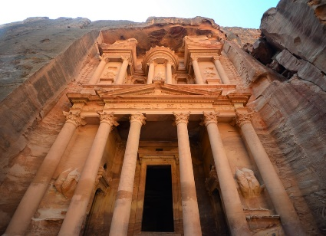
Private Tour
Jordan
Jordan Insight 4 nights
Weekly
Departures
On the Jordan Insight tour you will discover Jerash the “Pompeii of the Middle East”, Biblical landmarks, the “Rose Red City” of Petra a stunning architectural masterpiece, carved out of the mountain range. Venture into Wadi Rum to experience the amazing desert landscape and the Bedouin lifestyle. Relax at the Dead Sea, float & bathe in its healing salts & minerals..
Jordan
Day 1: | Arrive Amman. Meet and assistance upon arrival, transfer to hotel in Amman for dinner and overnight
Day 2: | Jerash – Madaba - Mount Nebo – Petra
 | Guided Tour of Jerash. The site is one of the best preserved Roman Cities in the world. Visit Mount Nebo where Moses viewed the Promised Land. The panoramic view encompasses the Jordan River valley, Dead Sea, Jericho and the Holy land. Visit Madaba, see the mosaic map of the Holyland, located in the 6th century church of St George. Continue to Petra for dinner and overnight.
Day 3: | Petra – Wadi Rum
 | Start the visit with a horse ride from the main gate of Petra to the entrance of the old city. Guided tour of the ancient Nabatean city of Petra, carved out of rose coloured stone. Petra is one of the Seven Wonders of the World and a UNESCO Heritage Site. Afternoon tour of Wadi Rum, known as Lawrence of Arabia country. View the amazing desert landscape in 4x4 vehicle. Return back to Petra for dinner and overnight. (OR option to overnight in the desert of Wadi Rum at Captain camp in a tent with facilities)
Day 4 | Petra – Dead Sea
 | Transfer from Petra to the Dead Sea. Day is free at leisure to relax & rejuvenate in the therapeutic salty water at the lowest point on earth. Enjoy floating experience at the lowest point on earth. Dinner and overnight
Day 5: | Breakfast at hotel, day free at leisure. Transfer to Amman airport for departure flight.
Wadi Rum
Jerash
Prices Based on Twin Share per person | LOW | 01/02 – 27/02/20 & 01/06 – 31/08/20
 | HIGH | 28/2 - 31/5/20 & 01/09 – 30/10/20
Hotels used for tour or similar on HB basis | No of persons | 2-3 adults from | 4-6 adults from | Single Room Suppl
4* Harrir or Sulaf hotel - Amman 1nt 4* Petra Guesthouse - Petra 2nts 4* Ramada Dead Sea - Dead Sea1nt | LOW | €1022 | €919 | €180
 | HIGH | €1054 | €953 | €208
5* Bristol Hotel - Amman 1 nt 5* Old Village hotel - Petra 2 nts 5* Holiday Inn Resort ead Sea 1 nt | LOW | €1115 | €1013 | €268
 | HIGH | €1270 | €1148 | €316
Petra
Dead Sea Extension –
2 nights. Transfer to the Dead Sea. Experience floating on the surface of the sea, indulge in a variety of Dead sea spa treatments at your spa hotel.
Package cost Includes:
Return flight from Larnaca to Amman - Royal Jordanian
4 nights hotel accommodation in twin sharing room
(2 nights Petra, 1 night Amman, 1 night Dead Sea)
Daily buffet breakfast
Evening Dinner at hotels
Private transportation throughout with driver
Tours to Jerash, Petra & Wadi Rum with local guides
Horse Ride in Petra
Visit to Mount Nebo and Madaba
Entrance fees to sights in program
23kilos luggage allowance per person with RJ
Airport tax included
Free entry Visa to Jordan
Not Included:
Lunches /drinks
Tips to driver, guides & horse boy
Travel insurance
OTHER POINTS OF INTEREST:
Jerash – see Roman Chariot Race
Wadi Rum – Stay in the desert overnight sleep under the stars (tent, basic accomm)
Petra – Visit little Petra or Petra by candlelight.
(3 evenings a week)
NOTES:
Extra nights stay is possible as preferred.
Flights out of Paphos to Amman are possible, ask for details with lower package rates.
Dead Sea
Flights from Larnaca with Royal Jordanian based on 4 nights
DEPART | LARNACA | AMMAN | RETURN | AMMAN | LARNACA
MON | 1940 | 2050 | FRI | 0930 | 1045
TUE | 0820 | 0930 | SAT | 2215 | 2330
WED | 1940 | 2050 | SUN | 1650 | 1805
THUR | 2240 | 2350 | MON | 1740 | 1855
FRI | 1130 | 1240 | TUE | 0620 | 1735
SAT | 2355 | 0125 | WED | 1740 | 1855
SUN | 1850 | 2000 | THUR | 2040 | 2155
Prices are indicative and subject to change according to flight and hotel availability. The tours are private. Solo travel supplement on request. Muslim and Easter holiday supplement may apply. Royal Jordanian flight supplement may apply on peak dates. Alternative hotels can be arranged. Other language guiding is possible. Edition1 01/02/20
Contact Chronos Travel 22464040 chronos@chronostravel.com www.chronostravel.com

